Slide 1
FY20 quality case（Red paper）summary

Slide 2
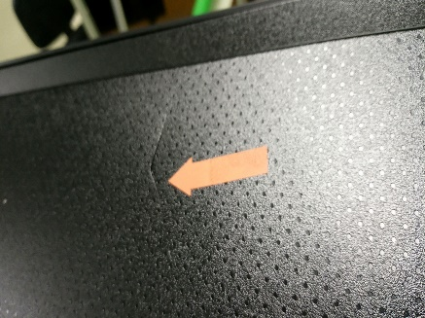
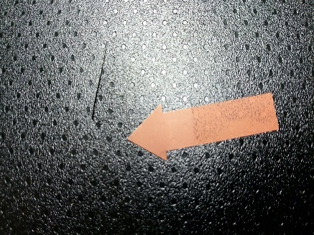
【J-Market】 20200804 RC broken at top side
Problem Details（不良症状） |  |  |  | Red paper NO. | PIC
RC broken |  |  |  | 20200804 | Feng
problem Detail |  |  |  | Occurred Date | Quantity
-RC broken at top side |  |  |  | 2020/08/02 | 1
Customer Status |  |  |  | FA Date | Parts
Found at Japan market |  |  |  | 2020/08/04 | RC
S/N NO. | Model | SSV line | shift | Found Plant | Stage
1806816 | NB55 |  |  | JAPAN MKT | MKT
Pictures（写真）
Progress Log
Action（改善対策） | Task Progress（内容詳細） | PIC: | Target | Status
1. Define the problem（定义问题） | -Found RC broken at custom house -UES TIME:0H -Suspect reason :when assemble the RC, knock it hard | Feng
2. Define & verify root cause （真因）
3. Short-term corrective action （暫定対策）
4. Permanent Corrective Action （恒久対策）

Slide 3
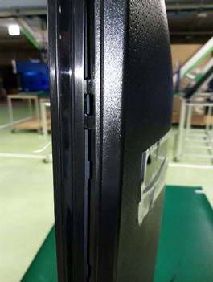
【J-Market】 20200802 right frame not assemble well
Problem Details（不良症状） |  |  |  | Red paper NO. | PIC
Frame not assemble well |  |  |  | 20200802 | Feng
problem Detail |  |  |  | Occurred Date | Quantity
Right side frame not assemble well |  |  |  | 2020/08/02 | 1
Customer Status |  |  |  | FA Date | Parts
Found at Japan market |  |  |  | 2020/08/02 | Frame
S/N NO. | Model | SSV line | shift | Found Plant | Stage
1808272 | NB65 |  |  | JAPAN MKT | MKT
Pictures（写真）
Progress Log
Action（改善対策） | Task Progress（内容詳細） | PIC: | Target | Status
1. Define the problem（定义问题） | -Found frame not assemble well at Japan market -UES TIME:0H -No abnormal found at frame hook | Feng
2. Define & verify root cause （真因）
3. Short-term corrective action （暫定対策）
4. Permanent Corrective Action （恒久対策）

Slide 4
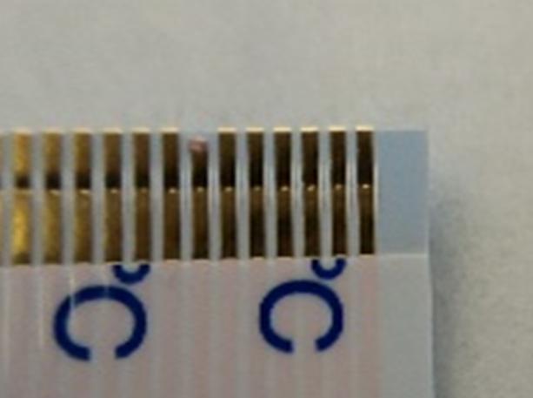
【J-Market】 20200802 FFC broken
Problem Details（不良症状） |  |  |  | Red paper NO. | PIC
FFC 30PIN broken |  |  |  | 20200802 | Feng
problem Detail |  |  |  | Occurred Date | Quantity
T-con-main board FFC 30pin broken |  |  |  | 2020/08/02 | 1
Customer Status |  |  |  | FA Date | Parts
Found at Japan market |  |  |  | 2020/08/02 | FFC
S/N NO. | Model | SSV line | shift | Found Plant | Stage
1806468 | NB65 |  |  | JAPAN MKT | MKT
Pictures（写真）
Progress Log
Action（改善対策） | Task Progress（内容詳細） | PIC: | Target | Status
1. Define the problem（定义问题） | -Found FFC broken (T-con –main board side 30pin) at Japan market -UES TIME:67H | Feng
2. Define & verify root cause （真因）
3. Short-term corrective action （暫定対策）
4. Permanent Corrective Action （恒久対策）

Slide 5
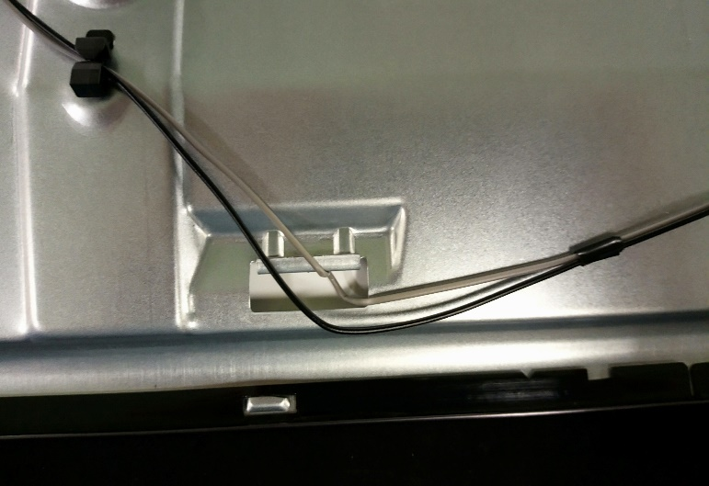
【J-Market】 20200727 SP cable hang on the hook
Problem Details（不良症状） |  |  |  | Red paper NO. | PIC
Lead line wiring error |  |  |  | 20200727 | Feng
problem Detail |  |  |  | Occurred Date | Quantity
SP cable hang on a hook |  |  |  | 2020/07/27 | 2
Customer Status |  |  |  | FA Date | Parts
Found at Japan market |  |  |  | 2020/07/27 | Cable
S/N NO. | Model | SSV line | shift | Found Plant | Stage
1805478 1805193 | NH55 |  |  | JAPAN MKT | MKT
Pictures（写真）
Progress Log
Action（改善対策） | Task Progress（内容詳細） | PIC: | Target | Status
1. Define the problem（定义问题） | -3X BLINKING -after analysis found the cable hang on the hook | Feng
2. Define & verify root cause （真因） | -cable too long -operation get some wrong | PE
3. Short-term corrective action （暫定対策） | -change the operation | Production | 1812571(NH55) 1816015(NH65) | FINISH
4. Permanent Corrective Action （恒久対策） | -request design side to add tape to fix the cable and reduce the cable length | Designh | - | TBD

Slide 6
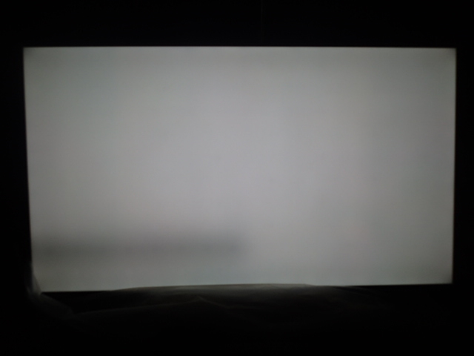
【INZ-Market】 20200727 NX85 LS CNT floating
Problem Details（不良症状） |  |  |  | Red paper NO. | PIC
LS CNT floating |  |  |  | 20200727 | Feng
problem Detail |  |  |  | Occurred Date | Quantity
Ls CNT is floating |  |  |  | 2020/07/27 | 1
Customer Status |  |  |  | FA Date | Parts
Found at INZ production process |  |  |  | 2020/07/27 | CNT
S/N NO. | Model | SSV line | shift | Found Plant | Stage
0004306 | NX85 |  |  | INZ | MP
Pictures（写真）
Progress Log
Action（改善対策） | Task Progress（内容詳細） | PIC: | Target | Status
1. Define the problem（定义问题） | -4X BLINKING -after analysis found the LS CNT is floating | Feng
2. Define & verify root cause （真因）
3. Short-term corrective action （暫定対策）
4. Permanent Corrective Action （恒久対策）

Slide 7
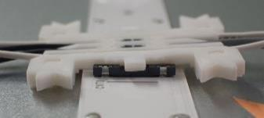
【INZ-Market】 20200720 NB55 LS CNT floating
Problem Details（不良症状） |  |  |  | Red paper NO. | PIC
LS CNT floating |  |  |  | 20200720 | Feng
problem Detail |  |  |  | Occurred Date | Quantity
Ls CNT is floating |  |  |  | 2020/07/20 | 2
Customer Status |  |  |  | FA Date | Parts
Found at J-MKT |  |  |  | 2020/07/20 | CNT
S/N NO. | Model | SSV line | shift | Found Plant | Stage
1803025 1800945 | NB55 |  |  | J-MKT | END USER
Pictures（写真）
Progress Log
Action（改善対策） | Task Progress（内容詳細） | PIC: | Target | Status
1. Define the problem（定义问题） | -6X BLINKING -after analysis found the LS CNT is floating | Feng
2. Define & verify root cause （真因） | -don’t assemble well | PE
3. Short-term corrective action （暫定対策） | -when assemble the CNT can not catch the harness ,need handle the CNT to fix -after assemble the CNT,need press the CNT again to make sure it fixed well | Production | NB55:1818756 NB66:1814262 | Finish
4. Permanent Corrective Action （恒久対策） | -Same as above actions

